Slide 1
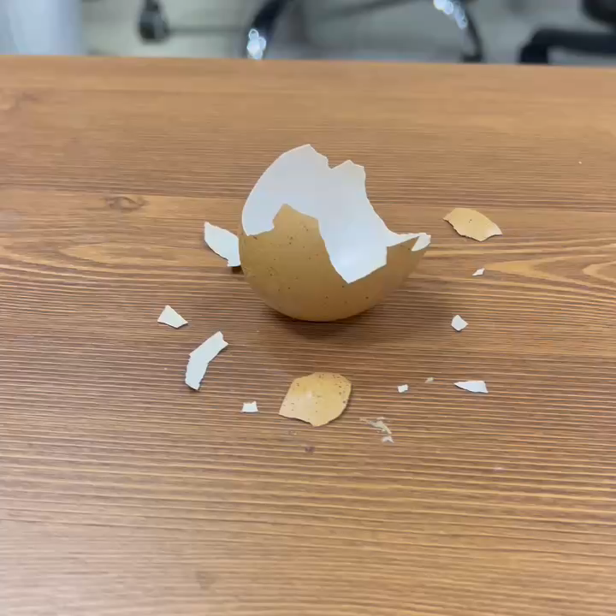

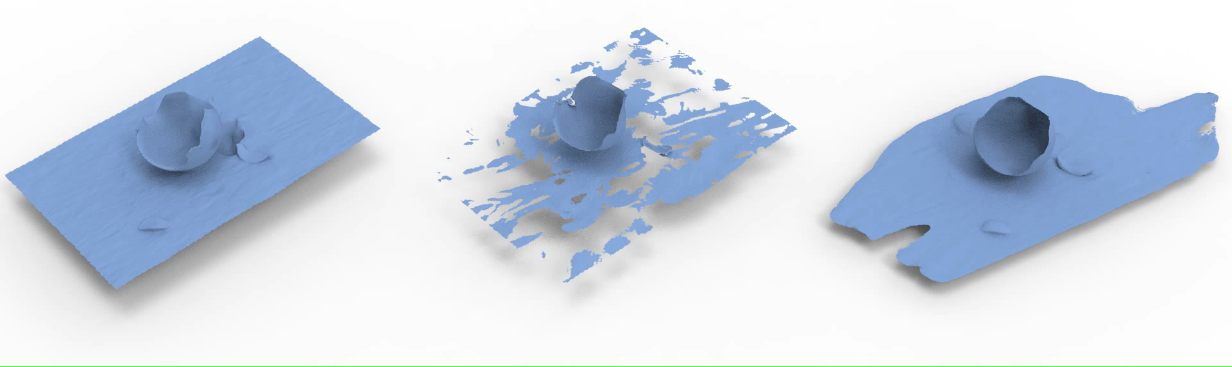
Input
Video
Our
Rendering
NeuS (SDF, Double Layers)
NeUDF (UDF, Single Layer)
Ours (UDF, Single Layer)

